Slide 1
Study Skills: Preparing for university
Referencing
Bobby Pathak - Effective Learning Service

Slide 2
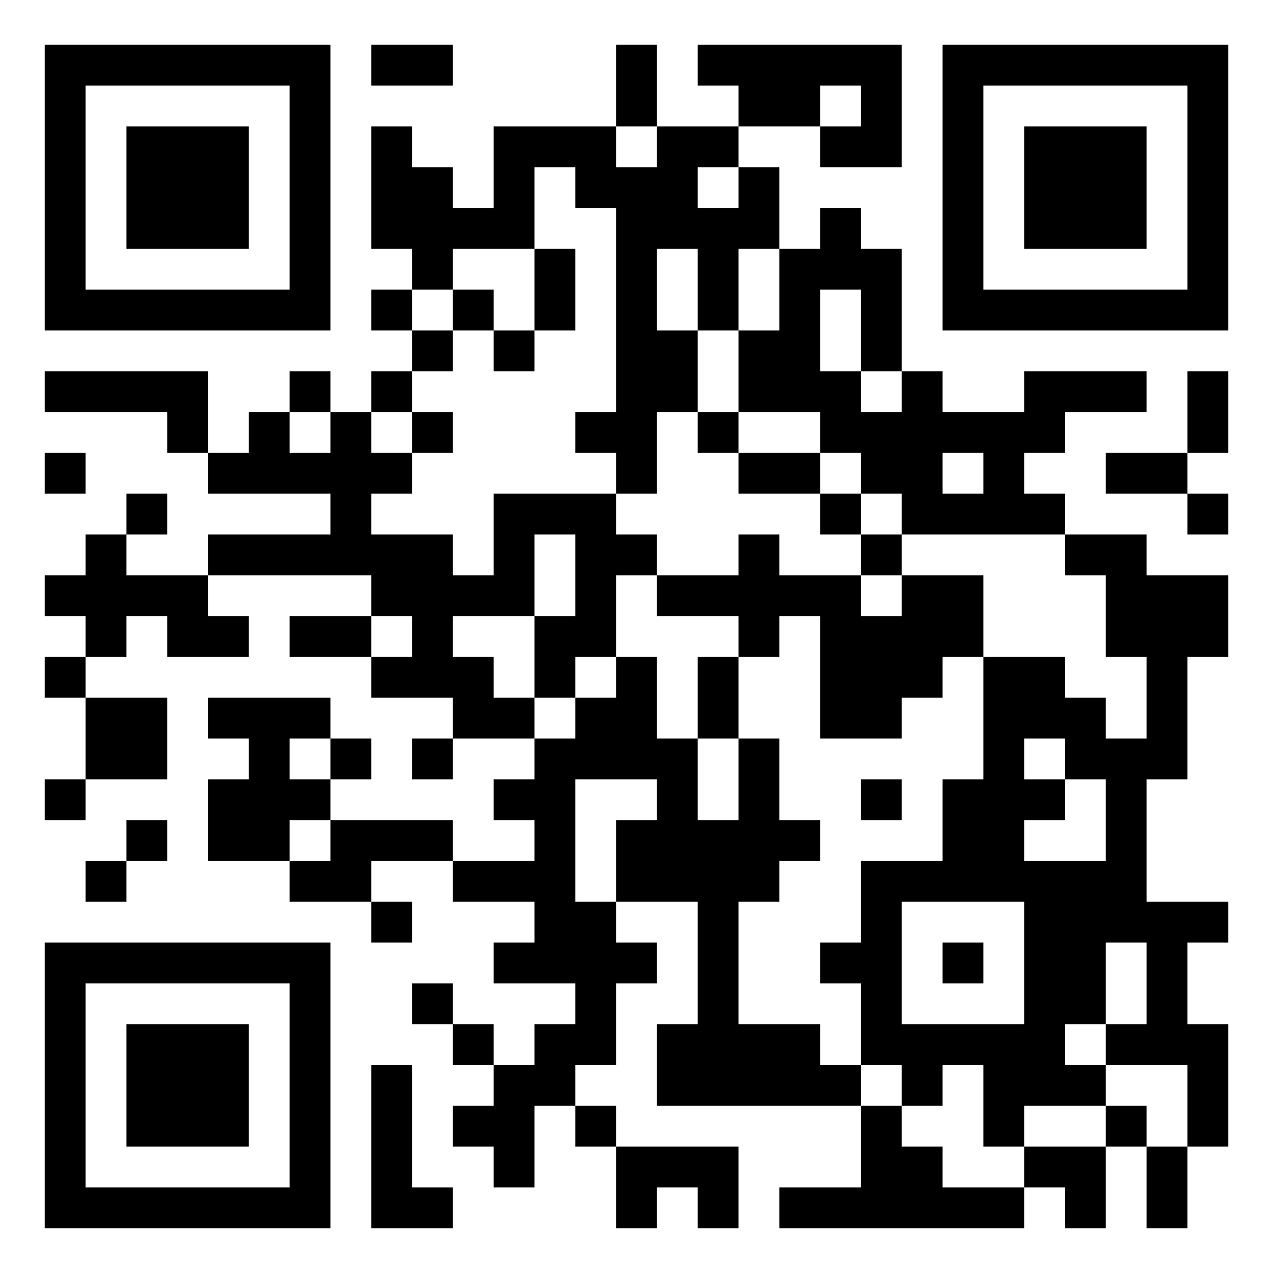
While we’re waiting for others to join, click the QR code & tell us your thoughts (it’s anonymous)!

Slide 3
‘The term plagiarism is usually used to refer to the theft of words or ideas, beyond what would normally be regarded as general knowledge’ (Park, 2003 p. 472).
(Altmann, no date)

Slide 4
How do we avoid the allegation of plagiarism?

Slide 5
What’s the purpose of referencing in academic texts and why do we use them?
How many referencing styles can you think of
How many variants within these styles do you think there are?
Why are there so many?

Slide 6
The Royal Literary Fund (2022) highlights four widely-used referencing conventions. They are called the MLA (Modern Languages Association) system, the APA (American Psychological Association) system, the Harvard system, and the MHRA (Modern Humanities Research Association) system. Particular referencing styles are preferred by particular academic disciplines because they work better with the kind of texts that are most commonly used in that discipline (University of Reading, 2022).
(Altmann, no date)

Slide 7
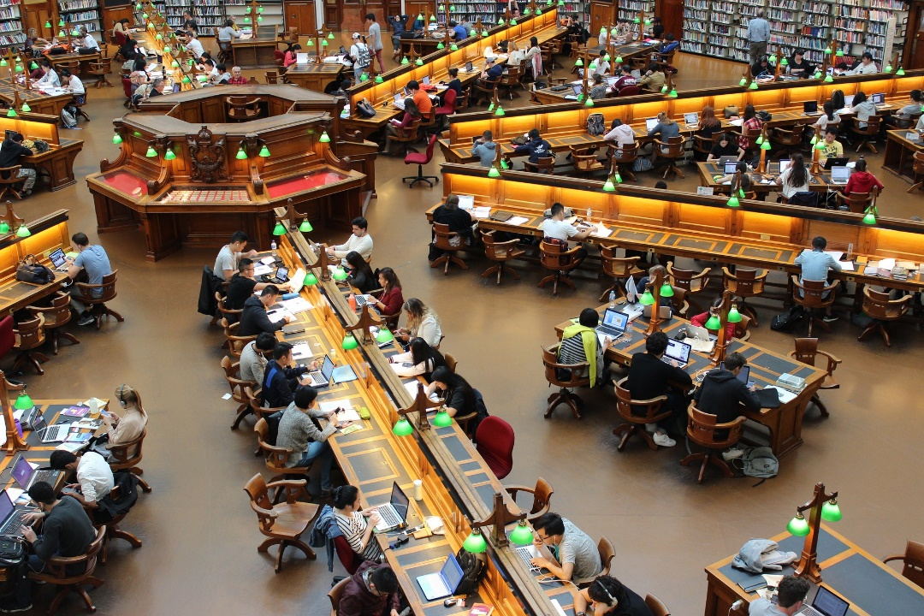
At QMU two different styles are used by different departments
APA and Harvard. It’s important you check the required convention with your department!
When you use someone else’s ideas in your work, you must reference the sources in order to:
(Tan, no date)

Slide 8
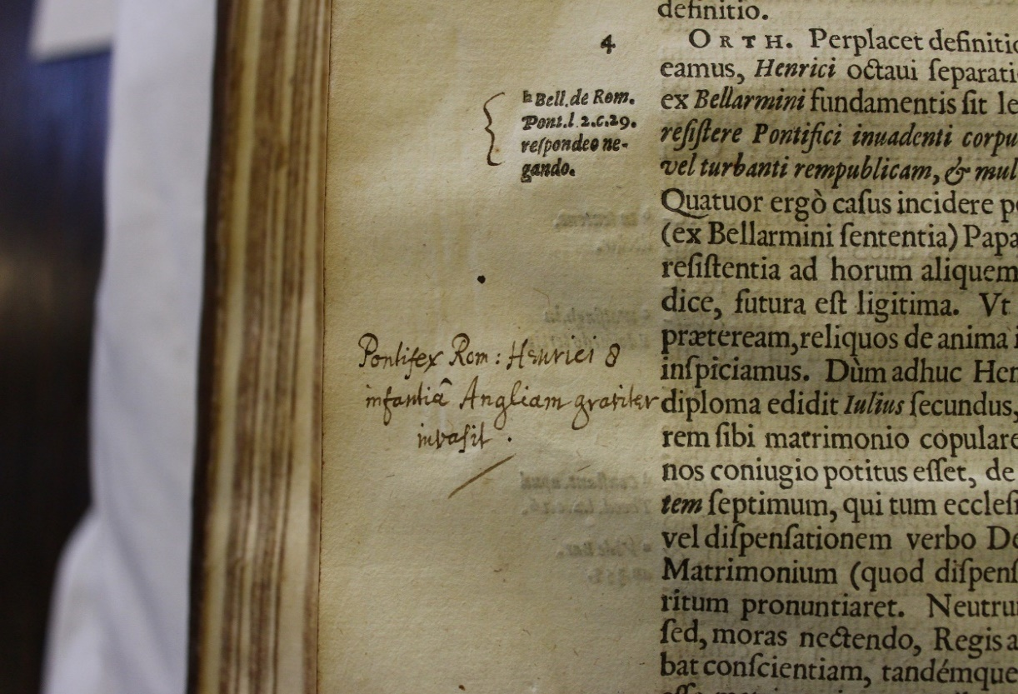
Show you are aware of other people’s ideas and are including them
Acknowledge other people’s ideas
Allow the reader to find the original material you have used
Support points and arguments you want to make
(Matuszewski, no date)

Slide 9
Plagiarism
Directly lifting
Bad paraphrasing
(University of South Australia, 2022)

Slide 10
What are the differences in citations here?
The Royal Literary Fund (2022) highlights four widely-used referencing conventions. They are called the MLA (Modern Languages Association) system, the APA (American Psychological Association) system, the Harvard system, and the MHRA (Modern Humanities Research Association) system. Particular referencing styles are preferred by particular academic disciplines because they work better with the kind of texts that are most commonly used in that discipline (University of Reading, 2022) .
”

Slide 11
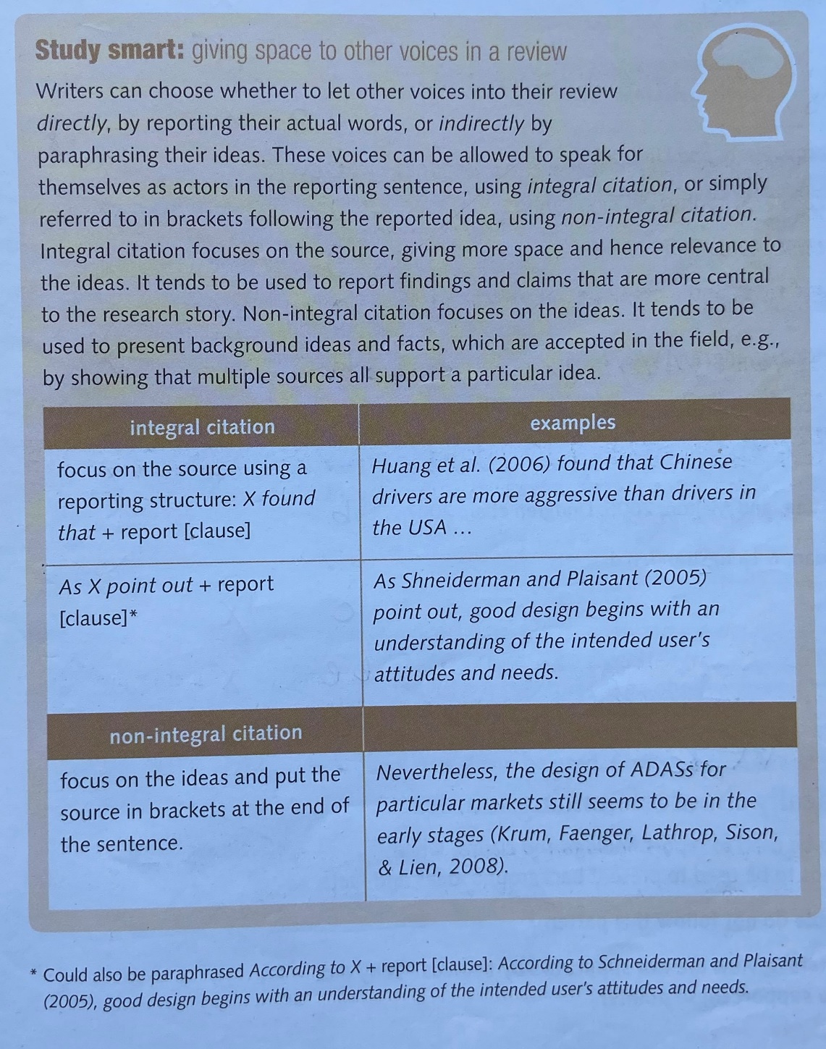
(Argent & Alexander, 2013)

Slide 12
Any questions?

Slide 13
References:
Altmann (no date). Books question mark [Digital Image]. Available at: https://pixabay.com/users/geralt-9301/?utm_source=link-attribution&amp;utm_medium=referral&amp;utm_campaign=image&amp;utm_content=4158244
Argent, S., & Alexander, O. (2013). Access EAP: Frameworks: Course Book with audio DVD. Garnet Education.
Park, C. (2003). In other (people's) words: Plagiarism by university students--literature and lessons. Assessment & evaluation in higher education, 28(5), 471-488.
Matuszewski (no date). Book note education [Digital image] Available ate: https://pixabay.com/users/mzmatuszewski0-825220/?utm_source=link-attribution&amp;utm_medium=referral&amp;utm_campaign=image&amp;utm_content=1850880

Slide 14
References:
University of Reading (2022). Citing References. Available at: https://libguides.reading.ac.uk/citing-references/referencingstyles#:~:text=APA%20referencing%20is%20a%20variant,a%20bibliography%20in%20APA%20style. (Accessed: 6 March 2022)
University of South Australia (2022). Using Turnitin. Available at: https://lo.unisa.edu.au/mod/book/view.php?id=252146&chapterid=39214. (Accessed: 6 March 2022)
Royal Literary Fund (2022). MLA, APA, Harvard or MHRA? Available at: https://www.rlf.org.uk/resources/mla-apa-harvard-or-mhra/#:~:text=Referencing%20styles,Modern%20Humanities%20Research%20Association)%20system. (Accessed: 6 March 2022)
Tan (no date). Library [Digital Image]. Available at: https://pixabay.com/users/andrew_t8-1822880/?utm_source=link-attribution&amp;utm_medium=referral&amp;utm_campaign=image&amp;utm_content=1400313

