Slide 1
The Climate Crisis Dr Andy Cross – School of GeoSciences 26th March 2023 andrew.cross@ed.ac.uk

Slide 2
What is the climate crisis?
The culmination of scientific and local knowledge
Evidence that we have fundamentally changed the global climate
That there are extremely negative consequences and action must be taken

Slide 3
Average global temperature increase by month
Source: UK Met Office

Slide 4
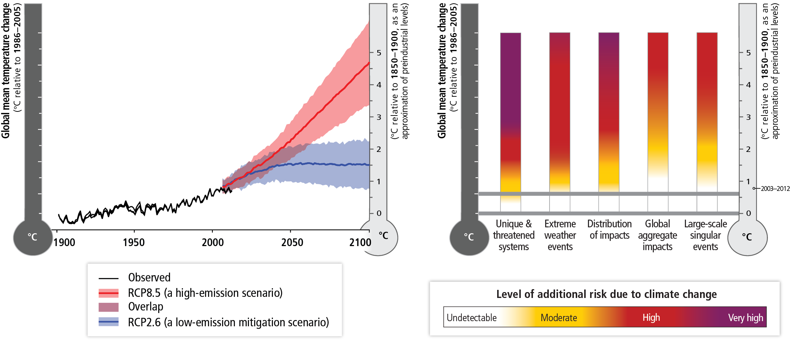
Notes:
When we talk about future warming we often refer to absolute changes in global average temperature, but this hides the regional variations in the speed of warming. We also tend to talk about annual average temperature or rain fall, but it is the extremes (such as heatwaves, droughts and floods) that usually have the greatest impacts.
In this lecture we'll look more closely at climate change impacts at the regional scale and how the physical climate changes and the level of resilience of a region combine to determine how severe impacts will be.
2 degrees of warming is what we must avoid – we are in the 1.5 into the yellow. But for some areas this will still be significant threat such as SIDS and extremely vulnerable populations. Adaptation will be harder for some than others.

Slide 5
Source: MetOffice 2019
Notes:
https://www.metoffice.gov.uk/weather/learn-about/climate-and-climate-change/climate-change/impacts/infographic-breakdown/global-drivers-of-climate-change

Slide 6
Top risks identified by Intergovernmental Panel on Climate Change –Assessment Report 5 (Working Group II)
Risk of death, injury, ill-health, or disrupted livelihoods in low-lying coastal zones and small island developing states and other small islands, due to storm surges, coastal flooding, and sea level rise.
Risk of severe ill-health and disrupted livelihoods for large urban populations due to inland flooding in some regions.
Systemic risks due to extreme weather events leading to breakdown of infrastructure networks and critical services such as electricity, water supply, and health and emergency services.
Risk of mortality and morbidity during periods of extreme heat, particularly for vulnerable urban populations and those working outdoors in urban or rural areas.
Risk of food insecurity and the breakdown of food systems linked to warming, drought, flooding, and precipitation variability and extremes, particularly for poorer populations in urban and rural settings.
Risk of loss of rural livelihoods and income due to insufficient access to drinking and irrigation water and reduced agricultural productivity, particularly for farmers and pastoralists with minimal capital in semi-arid regions.
Risk of loss of marine and terrestrial ecosystems, biodiversity, and the ecosystem goods, functions, and services they provide for coastal livelihoods.

Slide 7
Social impacts of Climate Change

Slide 8
Climate change resilience

Slide 9
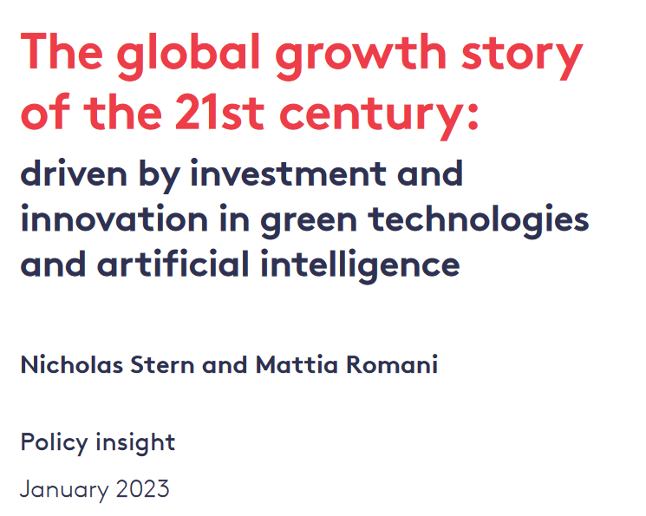
Some signs of hope?
Rapid acceleration in crucial green technologies
Growth of renewable energy sources
Risk of loss of rural livelihoods and income due to insufficient access to drinking and irrigation water and reduced agricultural productivity, particularly for farmers and pastoralists with minimal capital in semi-arid regions.
Risk of loss of marine and terrestrial ecosystems, biodiversity, and the ecosystem goods, functions, and services they provide for coastal livelihoods.

Slide 10
Thanks for listening!
Any questions?
andrew.cross@ed.ac.uk

Slide 11
Thanks for listening!
Any questions?
andrew.cross@ed.ac.uk

